Slide 1
The Organizational Dangers of a Man in the Middle Attack
Group 38: Tate, Mateo, and Juan

Slide 2
What is a Man in the Middle (MitM) Attack?
“A form of active wiretapping attack in which the attacker intercepts and selectively modifies communicated data to masquerade as one or more of the entities involved in a communication association.” - The National Institute of Standards and Technology
Notes:
A longer, more wordy definition from the National Institute of Standards and Technology: “A form of active wiretapping attack in which the attacker intercepts and selectively modifies communicated data to masquerade as one or more of the entities involved in a communication association.”

Slide 3
What is a Man in the Middle (MitM) Attack?
Client
Server
Safe, private flow of data between the Client and the Server
Notes:
This attack is under the basic precedent that there is a connection and a flow of information between two parties, whether that be a remote client accessing a server or two parties within an organization.

Slide 4
What is a Man in the Middle (MitM) Attack?
Client
Server
Attacker
An attacker secretly interposes themselves
Notes:
This can be enacted in many different ways, such as “spoofing” their IP or MAC address, pretending to be an intended receiver. This example is most likely a form of ARP poisoning, redirecting information flowing from both entities through itself.

Slide 5
What is a Man in the Middle (MitM) Attack?
Client
Server
Attacker
Once embedded, an attacker may take a number of passive or active actions
Notes:
Once embedded, an attacker may take a number of passive or active actions, depending on the nature of how they have interceded themselves. This could mean they passively gain confidential information, edit or alter messages, or remove the message altogether.

Slide 6


Risks
Data Leaks
Privacy Breach
Open to further Cyberattacks
Interception and Manipulation of Private Communication

Slide 7

2017 Equifax Data Breach
Example of a Risk in regards to MitM Attacks
Not a direct MitM Attack, but utilized elements of MitM
Company spent hundreds of millions fixing their mistake
145 Million people affected
One of the biggest data leaks in US History

Slide 8



Why This Threat Matters to a Company
What’s at stake for the business when attackers sit between your systems.
Assets at Risk
Business Impact
Bottom Line
Passwords, session data, internal secrets
Account takeover, fraud, regulatory fines
Loss of customer trust demands immediate investment.
Notes:
Alright, so here’s where we shift from the technical side into the business side — why a Man-in-the-Middle attack actually matters to a company.
First, Assets at Risk. When someone sits between your systems, they’re not just watching traffic — they’re pulling passwords, session tokens, and internal data straight out of the stream. That’s everything an attacker needs to impersonate employees or break into private systems.
Next, the Business Impact. Once they have those credentials, you’re looking at account takeover, fraudulent activity, and even regulatory fines if sensitive data gets exposed. This is where the technical problem turns into a business crisis.
And then the Bottom Line. When customers lose trust, the business pays for it — financially and reputationally. Even a small breach forces companies to invest immediately just to rebuild confidence and stop the bleeding.
So the big point here is: MitM isn’t just a hacker problem. It’s a business risk with real costs.”

Slide 9
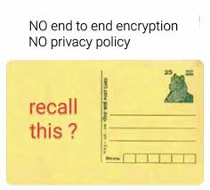

Mitigation:
TLS Everywhere
The industry standard for encrypting all web communication.
Postcard
Anyone can read
Encrypts all communication
Prevents attackers from reading intercepted data.
Verifies the server’s identity.
Sealed Envelope
Only the intended recipient can
Notes:
Alright, the first way we shut down a Man-in-the-Middle attack is TLS Everywhere.
TLS is basically the standard for encrypting all web communication — and the reason it matters is right here on this slide.
On the left, you can see the core benefits:
It encrypts all communication, so even if someone intercepts the traffic, it’s unreadable.
It prevents attackers from seeing things like passwords, session IDs, or private messages.
And it verifies the server’s identity so you’re actually talking to the real system, not a fake one pretending to be it.
To make it super simple, that postcard meme at the top tells the whole story. Unencrypted traffic is basically a postcard — anyone who touches it can read it.
But when you add TLS, it turns into a sealed, locked envelope — even if someone grabs it in transit, they can’t open it or see what’s inside.
So TLS doesn’t stop someone from intercepting packets, but it makes those packets useless. It removes the exact weakness that Man-in-the-Middle attacks rely on.

Slide 10
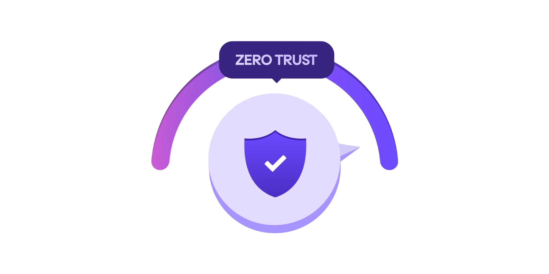
Mitigation:
Zero Trust Access
No “trusted” internal network
A security model that verifies every user, device, and request. No automatic trust.
Every request is authenticated
Blocks attackers even if they’re inside the network
Notes:
Now the second mitigation is Zero Trust Access.
The idea here is simple: the network stops assuming anyone is safe just because they’re ‘inside.’ There’s no trusted internal zone where devices get a free pass.
On the left side, you can see the core of Zero Trust — it verifies every user, every device, and every request, no matter what. There’s no automatic trust, even for employees or internal systems.
On the right, you can see what that means in practice:
No ‘trusted’ internal network — attackers can’t hide inside the environment.
Every request is authenticated — users constantly prove they’re legitimate.
And the biggest benefit: it blocks attackers even if they manage to get into the network, because they still can’t move around or access anything without meeting the same verification requirements as everyone else.
So while TLS protects the traffic, Zero Trust protects the access. Together, they close the main doors and the side doors attackers rely on in a Man-in-the-Middle scenario

Slide 11

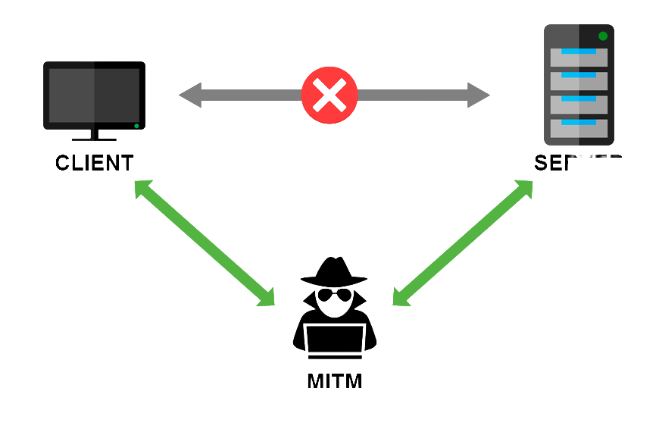
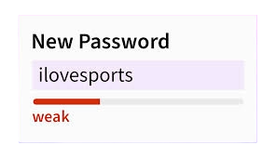

How MitM Gets Blocked
TLS Packet
MitM Packet Capture
Attacker can read everything
Passwords + session data exposed
User has no idea anything is happening
Encrypted Traffic
Unencrypted Traffic
Attacker still sees the packets
But contents are encrypted
Data becomes unreadable and useless

Slide 12
Our Recommendation
For our final recommendation, we propose a combined approach. TLS should be implemented everywhere as the baseline—it’s low-cost, easy to deploy, and immediately eliminates the biggest weakness MitM attacks rely on: readable traffic. Additionally, Zero Trust should be applied to systems that hold sensitive data or high-value accounts. These two controls provide practical, high-impact protection with minimal disruption to day-to-day operations.
Notes:
“So for our final recommendation, we’re going with a combined approach because it hits the problem from both angles without slowing the company down.
First, TLS everywhere. This should be the baseline. It’s low-cost, easy to roll out, and it eliminates the main thing a Man-in-the-Middle attack depends on — readable, unencrypted traffic. The moment data becomes encrypted, attackers lose the ability to steal anything useful.
Then we layer in Zero Trust for systems that hold sensitive data or high-value accounts. That means every request gets verified, even if someone is already inside the network. So even if an attacker manages to slip in, they’re basically stuck — they can’t move around or escalate.
Together, these two controls give the company strong protection with very little disruption to normal operations. It’s practical, realistic, and hits the highest-impact risks first

Slide 13
Sources
https://csrc.nist.gov/glossary/term/man_in_the_middle_attack
https://awareforce.com/equifax-man-in-the-middle-attack

